Slide 1

AUTOMATED SUPERMARKET NAVIGATION AND GUIDANCE SYSTEM

Slide 2
Team
Suchith B S
01JST16EC092
Srivatsa M N
01JST16EC091
V Shaashwath
01JST16EC108
Sumanth S
01JST16EC096

Slide 3
Contents
Overview
Implementation
Advantages and Bottlenecks
Project objective
Hardware Architecture
Target audience & Applications
Problems to solve
Software Architecture
Future Works
Literature survey
Demonstration
Understanding the Market
Simulation

Slide 4
Overview
Through the course of this presentation we shall be looking at the overall design of the entire system. The ecosystem of this project consists of both software and hardware elements of the projects with in depth analysis of every vertical explored.
The product focuses on creating an ecosystem of it’s on inside a predefined environment with subject to static or dynamic changes.

Slide 5
Project Objective
To create a personalized shopping assistant robot for a customer in a shopping environment. Highly intuitive UI and intelligent hardware facilitation or the user for a personalized and hassle free shopping experience.

Slide 6
Problems to Solve
1
Have you ever got lost in a Mall/Supermarket ?
3
Can’t find where your product is ?
2
Had too many things to buy in too little time ?
4
Ended up buying more than you needed ?

Slide 7

Understanding the Market

Slide 8
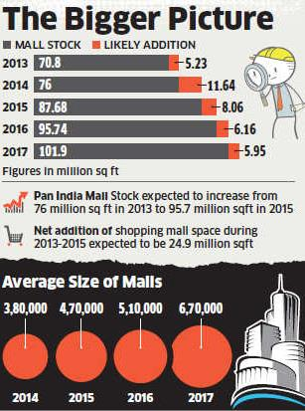
Market Trends
Statistics show that the ever-growing size of shopping malls are gradually rising.
This increases the complexity and maneuverability of such gigantic structures
Reports show that not just shopping malls but warehouses and factories are following the same trends

Slide 9
Literature Survey
The previous works done regarding a path following robot system, they track human movements and they adopt a visual aid i.e. camera to do this process.
Image processing principles adopted in the previous works, have adopted machine learning and deep learning techniques in implementation.
Proposed system eliminates the machine learning part as the path to be followed by the bot is dynamic in nature and would be implemented using shortest distance algorithm.

Slide 10
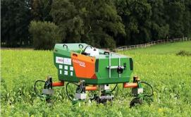
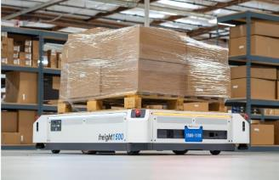
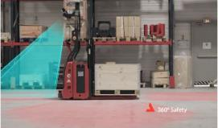
Existing Systems
Warehouse :
Balyo forklift
Freight 1500
Agriculture:
Driverless tractor
Bonirob

Slide 11
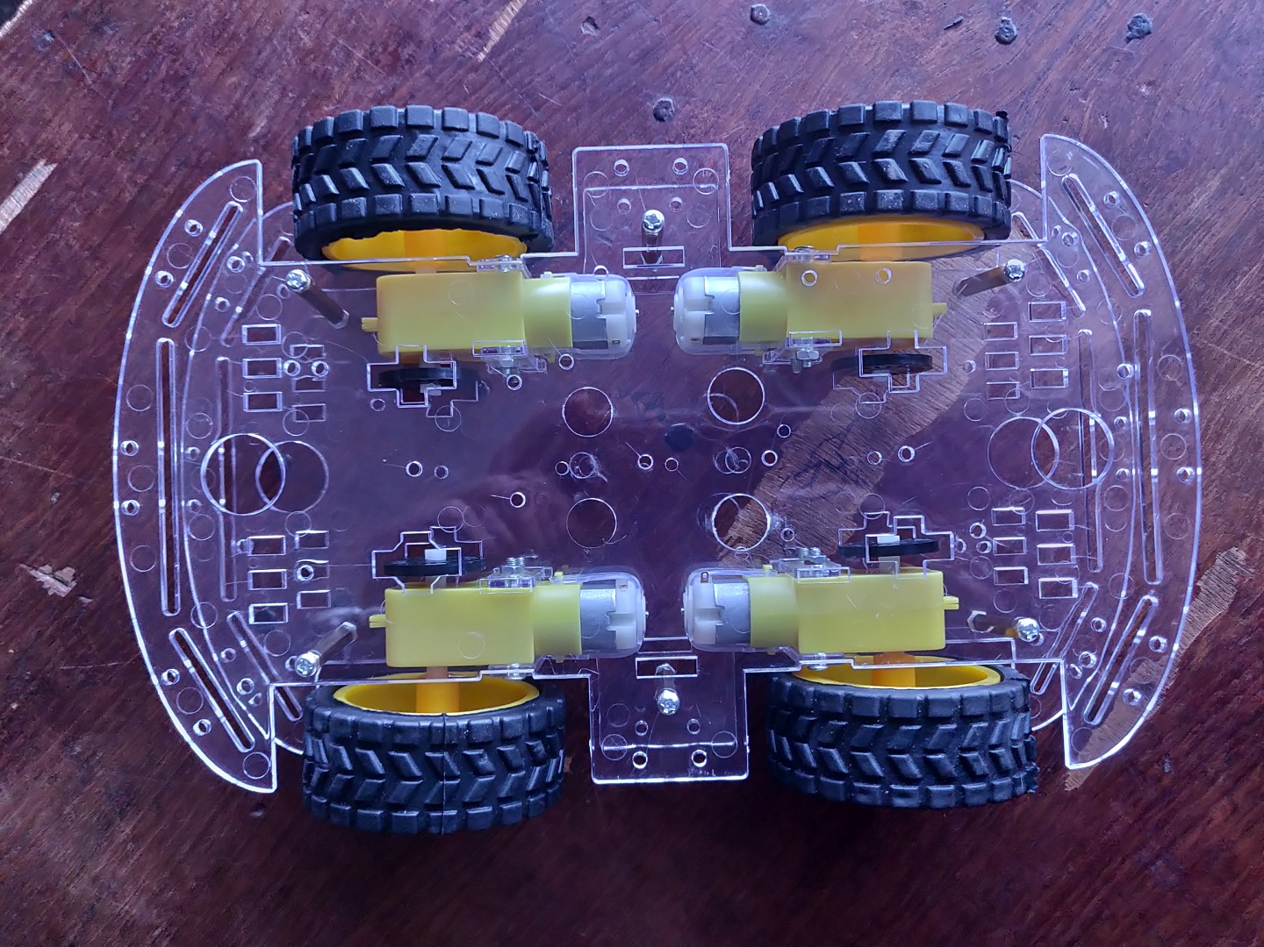

Implementation

Slide 12


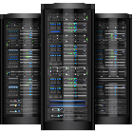
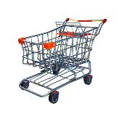
Base Structure
Customer
Chooses the products and the trolley
1
App
Customer uses the App as a control mechanism of the robot (Joystick).
2
Robot
Actuates based on the inputs given after running the algorithm
3
Server
This is where the magic happens, the brains of the algorithm lies in the server
4

Slide 13
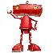




Architecture
Software
Application
Algorithm
Network
Hardware
Actuation
Collision Prevention

Slide 14
Hardware Components
Software components
Raspberry Pi 4B (2GB)
MPU6050 Gyro Sensor
IR array
HC-SR04 Ultrasonic Sensor
Micro SD card(32GB)
Motor Driver L298N
Robot Chassis
DC gear motors with encoder
Power bank and Battery
Ubuntu16.04 LTS
Balena Etcher
Raspbian OS
Python 3.8.2
VNC Viewer
Android studio 3.5.2

Slide 15
GUI Necessity
User interface must be created for a user who’s shopping with the robot for ease of access and manoeuvrability.
The robot intelligently navigates throughout the shopping mall whilst avoiding any collisions in its path. This application aids this elegant hardware system to redefine shopping experience.

Slide 16
Software Overview
Category of Application: Lifestyle and Utility
Platform Support: Android (5.0 and Higher)
Software Tool: Android Studio
Package Size: 3 MB (3,114,084 bytes)
Dependencies: QR Scanner – Zxing Scanner view
APIs : No REST or Active API used

Slide 17
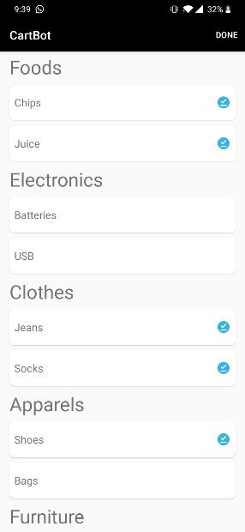
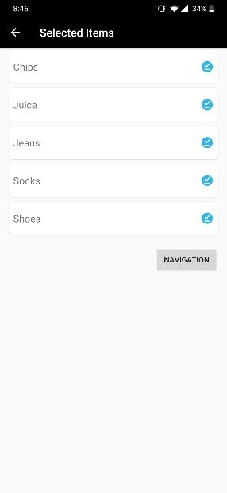
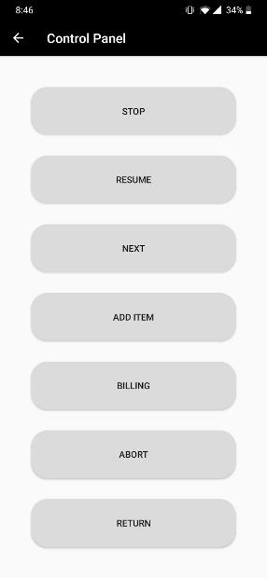
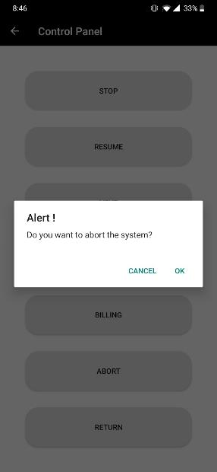

Application

Slide 18

Software Demonstration

Slide 19
Hardware Structure
User Control
Dynamic control parameters for user
1
Navigation and Collision detection
Shortest path navigation while preventing any collisions
2
Product procurement and Billing Goal Achievement and automatic billing redirection
3

Slide 20
Hardware Organization
Rpie 4 B+
Gyroscope Sensor
UltraSonic Sensors
The robot consists of the components as seen in the flow chart.
Power Source = Power Bank + Lead Acid Battery
Motor Driver
Motors
IR Sensor

Slide 21
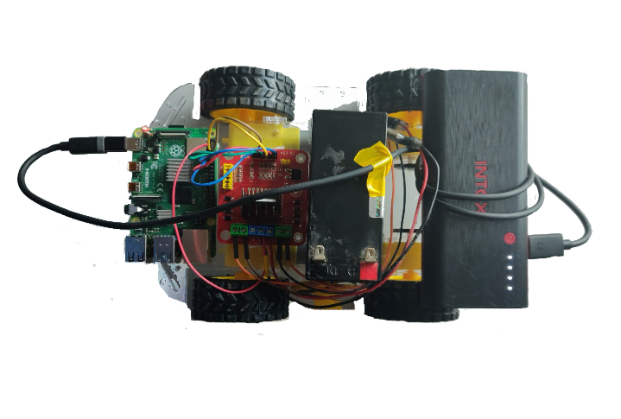
Hardware Assembly
Wheels
Chassis
Rpie 4B+
PowerBank
Type C cable
Gyro Sensor (underneath)
L293D MD
Lead Acid Battery

Slide 22
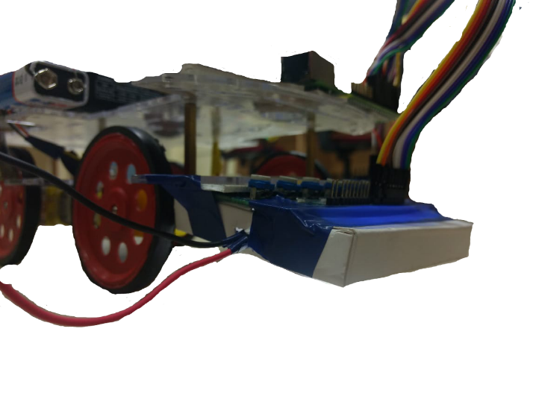
9V Battery
Digital Pins
IR shield
IR array
LED

Slide 23
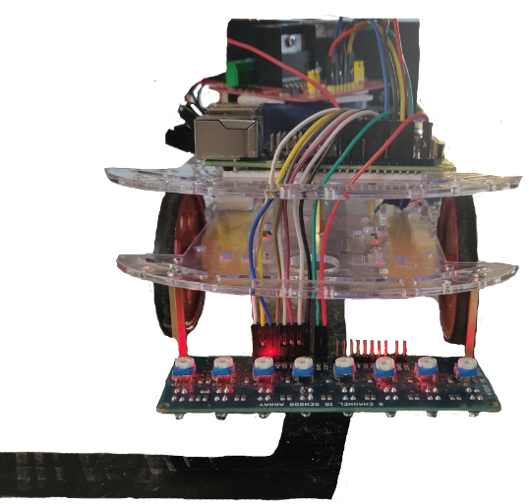
Holder
Calibrator
8 Array PCB
IR TX-RX pair
Black Track

Slide 24
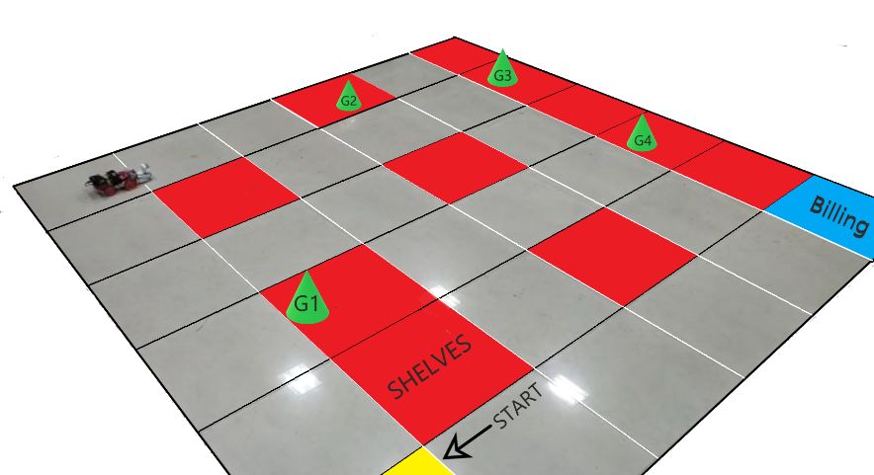
Physical Layout
Product
Robot
Path

Slide 25
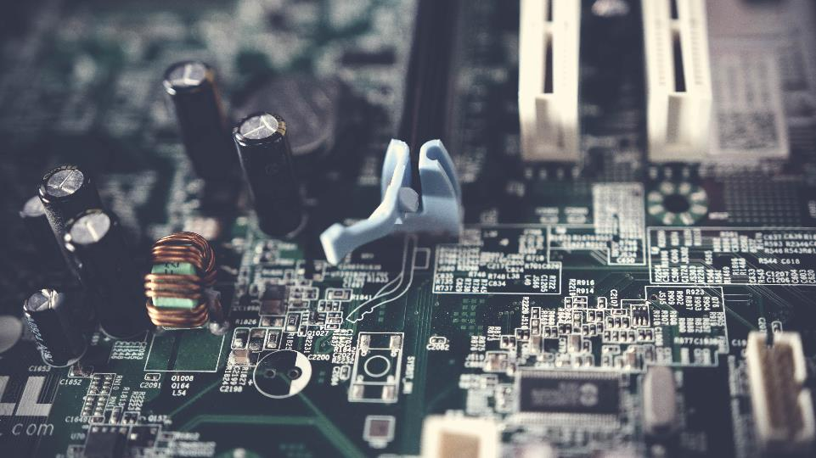
Hardware Demonstration

Slide 26

Simulation

Slide 27
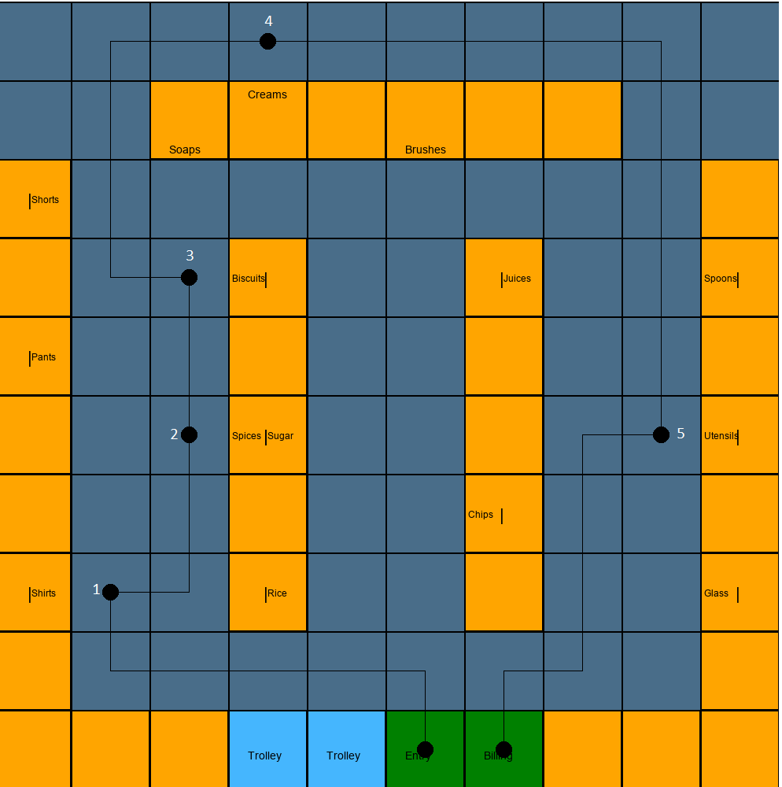
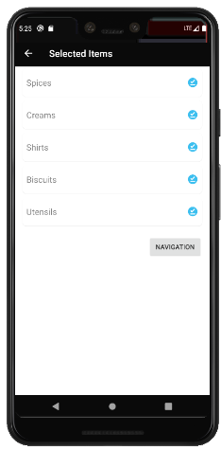
Simulation Results
The figure on the left depicts the selected items.
The figure on the right depicts the path taken by the robot after achieving each goal one after the other respectively.

Slide 28
Advantages
User Friendly
Scalable
The GUI combined with intelligent control
Framework developed can be scaled and versatile
Robust and Versatile System
All these factors help this product to be robust and function with the respective objectives being completed with utmost precision.
Highly Efficient
Autonomous
Algorithm used provides best solution and is time effective
No human intervention required and less administrator supervision

Slide 29
Bottlenecks
Static Map
Network Vulnerability
Overcrowding
Hardware Failure

Slide 30
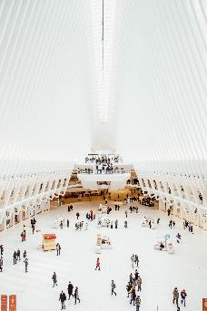
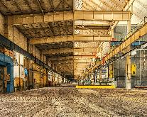
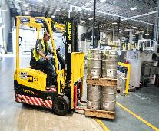
Target audience & Applications
Since the product developed has a skeletal architecture it can be applied to a plethora of different environments.
01 | Shopping Marts
02 | Malls
03 | Factories
04 | Warehouses

Slide 31
Future works
Hardware upgrades
Algorithm Refinement
Overall hardware structural upgrades
Increased performance and decreased time consumption
Robust and Versatile System
The future works can improve the product’s capabilities ten fold.
Scalability
Software upgrades
Multiple clients and troubleshooting capabilities
Bug fixes , Updates and Cloud support

Slide 32
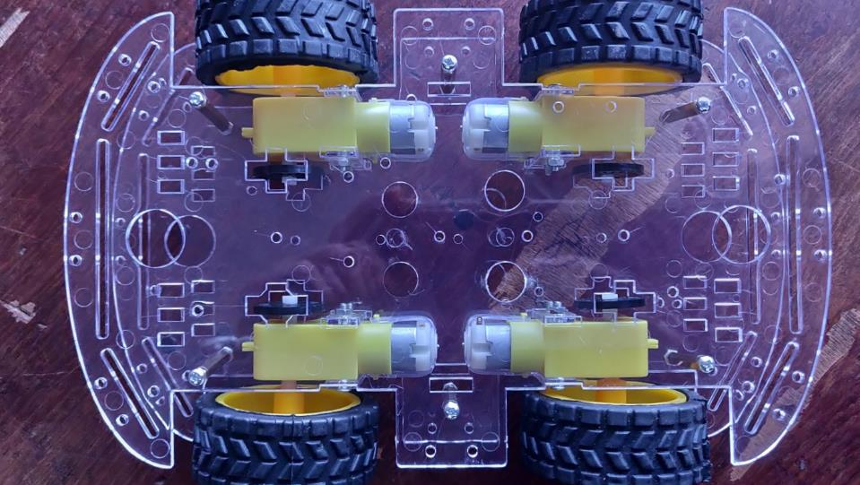
Thank you

